Slide 1
King County Housing Analysis
Reza

Slide 2
King County Housing Analysis
Introduction
Data Cleaning Process
Assumptions Made
Data Filtering Criteria
Results: Selected Houses
Geographical Plot

Slide 3
Introduction
Optimal Property Selection: Choosing a property meeting client requirements ensures satisfaction.
Jacob Phillips
Unlimited Budget,
4+ bathrooms ,
big lot (tennis court , pool and golf),
historical,
no waterfront

Slide 4
Data Cleaning Process
Fixing column names formats
Changing format of columns
Making the number of bathrooms sensible
Identifying missing values in waterfront column
Droping unnecessary columns

Slide 5
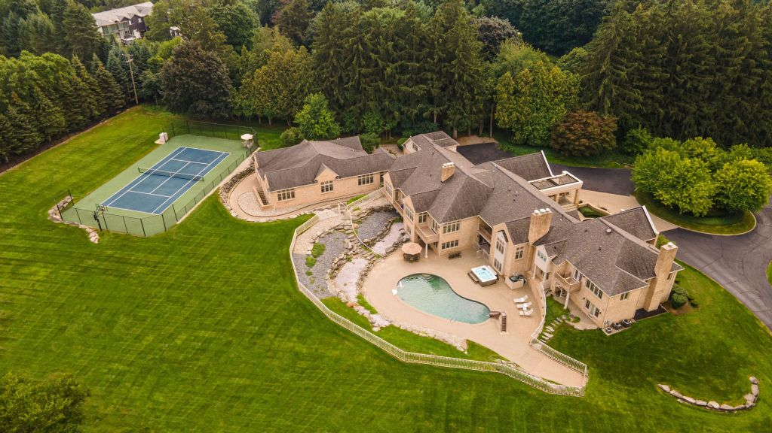
Assumptions Made
Key Assumptions:
Lot Size:
Minimum of 43,500 square feet.Provides ample space for amenities such as a pool, tennis court, and small golf practice area.
Historical Houses:
Houses older than 50 years.
Built before 1974 to classify as historical.
No renovation after 1974
The Oakland Press

Slide 6
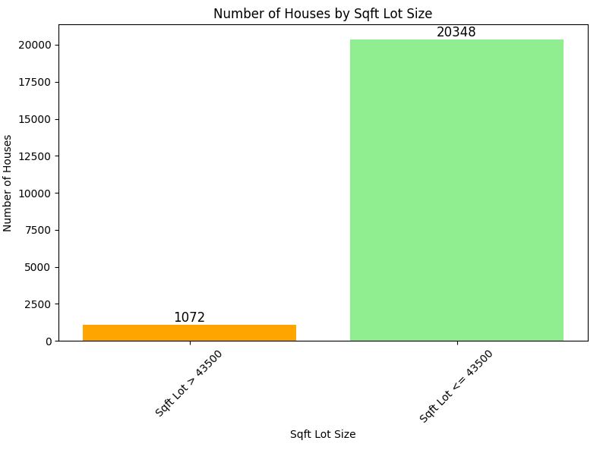
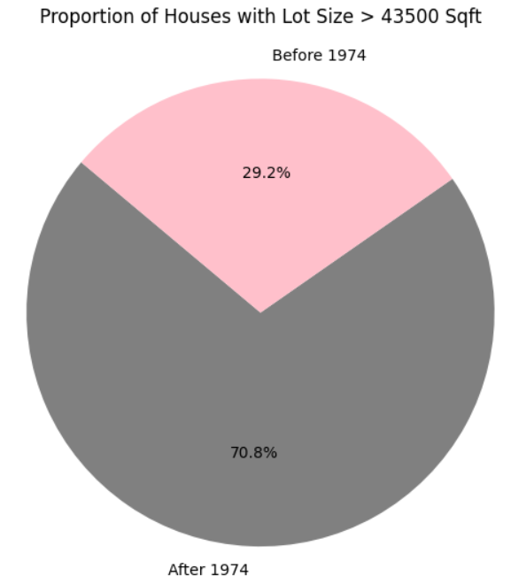
Assumptions plots

Slide 7
Data Filtering Criteria
Houses with at least 4 bathrooms
Houses with high grades(10-12)
High condition (4-5)
No waterfront

Slide 8
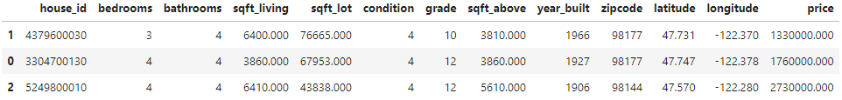
Results: Selected Houses

Slide 9
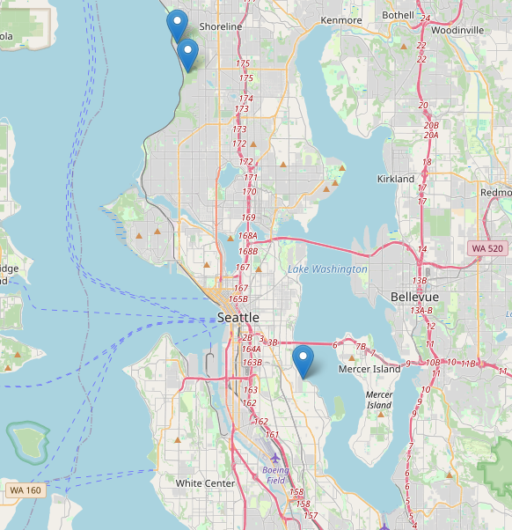
Geographical Plot
Two houses are in Shoreline
one is in Seattle near Mercer Island

